Slide 1
Fractures of the clavicle

Slide 2
Introduction
incidence
clavicle fractures make up ~4% of all fractures
demographics
often seen in young active patients
Associated with:
ipsilateral scapular fracture
scapulothoracic dissociation
should be considered with significantly displaced fractures
rib fracture
pneumothorax
neurovascular injury

Slide 3
Mechanism of injury
direct blow to lateral aspect of shoulder
fall on an outstretched arm or direct trauma
pathoanatomy
in displaced fractures, the sternocleidomastoid muscle pulls the medial fragment posterosuperiorly, while pectoralis and weight of arm pull the lateral fragment inferomedially
open fractures buttonhole through platysma

Slide 4
Classification
Allman classification
Group I - Middle third (80-85%)
Group II - Neer Classification of Lateral third (10-15%)
Group III - Medial third (5-8%)

Slide 5
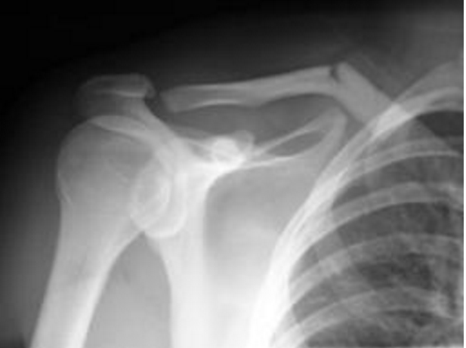
Image

Slide 6
Signs and symptoms
Symptoms
shoulder pain
Physical exam
deformity
perform careful neurovascular exam
tenting of skin (impending open fracture)

Slide 7
Imaging
Radiographs
standard AP view of bilateral shoulders
to measure clavicular shortening
45° cephalic tilt determine superior/inferior displacement
45° caudal tilt determines AP displacement
CT
may help evaluate displacement, shortening, comminution, articular extension, and nonunion
useful for medial physeal fractures and sternoclavicular injuries

Slide 8
Management
sling immobilization with gentle ROM exercises at 2-4 weeks and strengthening at 6-10 weeks
indications
nondisplaced Group I (middle third)
stable Group II fractures (Type I, III, IV)
nondisplaced Group III (medial third)
pediatric distal clavicle fractures (skeletally immature)

Slide 9
Sling Immobilization
technique
sling or figure-of-eight (prospective studies have not shown difference between sling and figure-of-eight braces)
after 2-4 weeks begin gentle range of motion exercises
strengthening exercises begin at 6-10 weeks
no attempt at reduction should be made

Slide 10
Management
open reduction internal fixation
indications
absolute
unstable Group II fractures (Type IIA, Type IIB, Type V)
open fxs
displaced fracture with skin tenting
subclavian artery or vein injury
floating shoulder (clavicle and scapula neck fx)
symptomatic nonunion
posteriorly displaced Group III fxs
displaced Group I (middle third) with >2cm shortening

Slide 11
Complications
Nonoperative treatment
nonunion (1-5%)
treatment of nonunion
if asymptomatic, no treatment necessary
if symptomatic, ORIF with plate and bone graft (particularly atrophic nonunion)

Slide 12
Complications
Operative treatment
hardware prominence
~30% of patient request plate removal
superior plates associated with increased irritation
neurovascular injury (3%)
superior plates associated with increased risk of subclavian artery or vein penetration
subclavian thrombosis
nonunion (1-5%)
infection (~4.8%)
mechanical failure (~1.4%)
pneumothorax
adhesive capsulitis
4% in surgical group develop adhesive capsulitis requiring surgical intervention

